Slide 1
ACPI简介
BIOS 段钧
2020/06/18

Slide 2
ACPI Structure
ACPI Power Management Model
ACPI table,ASL Code

Slide 3
ACPI Structure
ACPI(Advanced Configuration and Power Interface)，是新的电源管理规范，
用于取代APM，是OSPM(OperatingSystem-directed configuration and Power
Management)的关键组成部分
ACPI System定义了ACPI Hardware，ACPI BIOS和ACPI OS在ACPI规范中，硬件
由OS管理控制，BIOS is a Reporter

Slide 4
ACPI Structure

Slide 5
ACPI Power Management Model
ACPI defines various states for introducing OS driven Power Management
Global States (Gx) : Entire System
Sleep States (Sx) : Apply to the Processor, Clock Subsystem, Core Logic & Memory
Processor (Cx) : Processor Subsystem
Device States (Dx) : Peripheral Devices such as IDE

Slide 6
ACPI Power States
Power
Failure
Modem
HDD
D3
D3
CDROM
CPU
D2
D2
D3
C3
D1
D1
D2
C2
G3 -Mech
D0
D1
C1
D0
D0
C0
Off
C0
BIOS
Routine
G0 (S0) -
S4
Legacy
Working
S3
S2
S1
Wake
G1 -
Event
Sleeping
G2 (S5) -
Soft Off

Slide 7
ACPI : Processor States

Slide 8
ACPI : Sleep States

Slide 9
S1 : Stop Grant
S2 : CPU power off, chipset and memory
maintains the entire context
S3 : CPU power off, memory is low powered, PM
register are maintained
S4 : Suspend to Disk
OS : OS must save and restore all the context( memory and CPU, chipset
registers )
BIOS : BIOS must save and restore all the context( memory and CPU,
chipset registers )
All states translation are dominated by OS, instead of BIOS

Slide 10
ACPI : Register Model
ACPI Systems use SCI Interrupt to indicate the occurrence of an ACPI Event to the Operating System. The ability to generate an SCI is controlled by Enable Bits. Each Status Bit in ACPI Register Space (in Fixed / Generic except for WAK_STS) has a corresponding _EN Bit to generate an SCI when the Status bit is Set when an event happens.
SCI is connected to one of the PIC / 8259 Interrupts or one of the APIC Interrupt lines.

Slide 11
ACPI : Register Model
Fixed feature
List the features of the chipset in PM1 and PM2
The features are fixed, and the behavior is also fixed, OS ACPI driver handles the related events.
Generic feature
List the events in GP BLKs, and also write the Control Method in the name space using ASL.
The feature belong to OEM, this allow more flexible implemented, both Control method and OEM driver must response, instead of OS ACPI driver.

Slide 12
ACPI table,ASL Code
ACPI table作用：
对Hardware interface ，系统信息，Feature和Method的描述，
OS boot的时候，OSPM find ACPI table and use其中的信息
ACPI table 列举：
(RSDP)Root System Description Pointer
(RSDT)Root System Description Table
(FADT)Fixed ACPI Description Table
(FACS)Firmware ACPI Control Structure
(DSDT)Differentiated System Description Table
(SSDT)Secondary System Description Table
(XSDT)Extended System Description Table
其他等

Slide 13
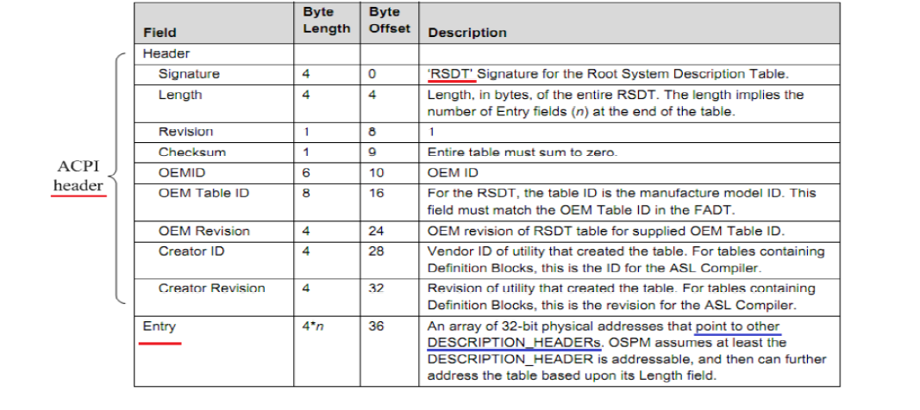
ACPI table,ASL Code
ACPI table 列举

Slide 14
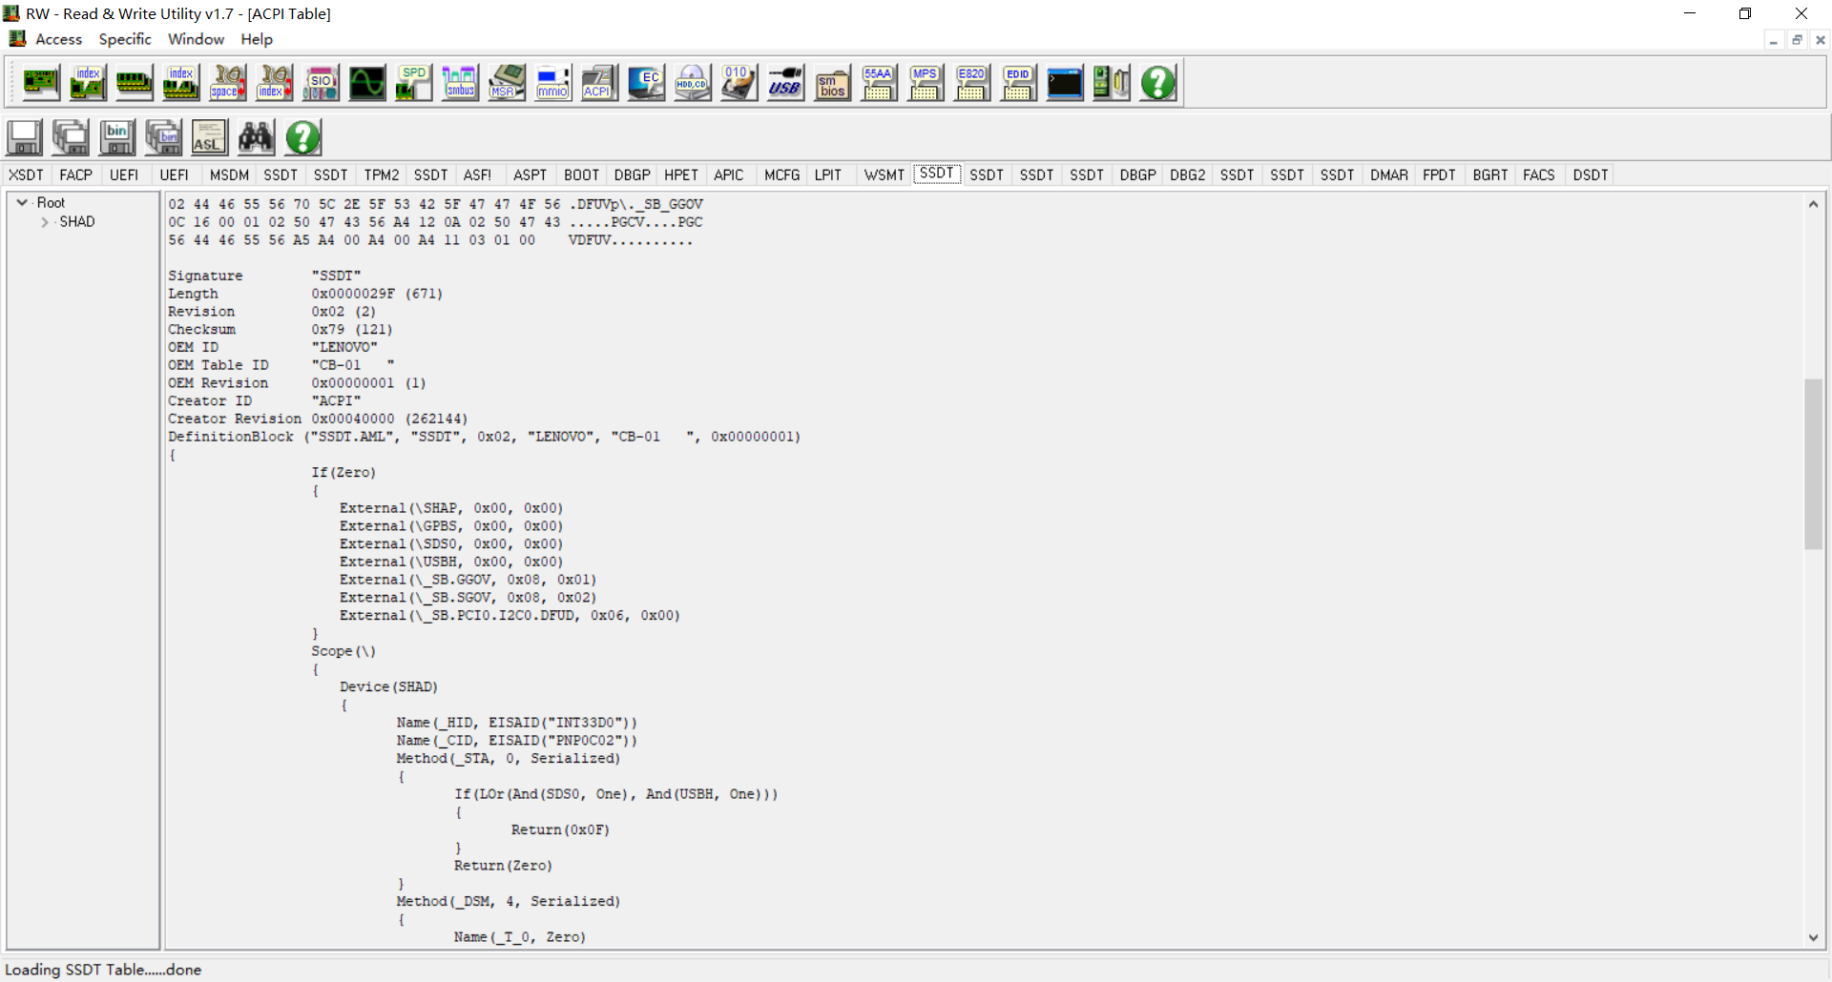
ACPI table,ASL Code
Windows下可以用rw 查看Acpi Table

Slide 15
ACPI table,ASL Code
ASL(ACPI Source Language)：
ASL(ACPI Source Language)编译之后得到AML(ACPI manchine Language)，置于ACPI table中，ASL用来定义ACPI objects，包括ACPI control methods等，可以控制hardware，读写register等
Method，类似C语言中的函数，可以被其他Method或者OS调用
ASL是高级语言，由OS Aspm驱动解释执行，具体请参考ACPI Spec
简单举列：
声明变量 : Name(Data, 0)
声明函数 : Method (fun1, 0x0)
声明Device: Device(COM3)
描述一段内存：Memory32Fixed(ReadWrite, 0xFED81500, 0x300)
描述一组IO：IO (Decode16, 0x3E8, 0x3E8, 0x01, 0x08)
........

Slide 16
作业
_PTS ASL函数向io 0x80写0x66, _WAK ASL函数向io 0x80写0x67

